Slide 1
Random Forest

Slide 2
Learning Objectives
What is Ensemble Modeling?
What is Bagging?
Random Forest Algorithm
Out of Bag Error Rate
Finding Optimal Number of Trees
Finding Optimal Number of Variables to Select

Slide 3
Some Concepts
Ensemble : use of multiple learning algorithms to obtain better predictive performance than could be obtained from any of the constituent learning algorithms
Bootstrap aggregating, also called bagging: Given a standard training set D of size n, bagging generates m new training sets Di, each of size n′, by sampling from D uniformly with replacement. By sampling with replacement, some observations may be repeated in each Di. The kind of sample is called Bootstrap. The m models are fitted using the above m bootstrap samples and combined (aggregated) by averaging the output (for regression) or voting (for classification).
https://en.wikipedia.org/wiki/Bootstrap_aggregating

Slide 4



Random Forest
Ensemble Technique
Involves constructing multitude of decision
trees at training time
Prediction is based on mode for classification tree and mean for regression tree
Help reduce over-fitting
– Note: there is possibility of high over-fitting at individual tree level but averaging removes the bias

Slide 5
RF Algorithm
Step 1: Random Sampling with replacement
ID | A1 | A2 | A3 | … | A(M) | Class
R1
R2
R3
.
.
.
Rn
ID | A1 | A2 | A3 | … | A(M) | Class
R10
R3
R15
R4
.
.
D1
D2
Dn
D…
ID | A1 | A2 | A3 | … | A(M) | Class
R1
R1
R100
R500
.
.
ID | A1 | A2 | A3 | … | A(M) | Class
R1
R1
R100
R500
.
.
ID | A1 | A2 | A3 | … | A(M) | Class
R1
R1
R100
R500
.
.

Slide 6
RF Algorithm… contd
Step 2: Building the tree for each sample with only partial set of ‘m’
variable being considered at each node
m << M where M is total number of predictor variables
Only a partial list of variables are considered for splitting based on the best variable from the partial list
ID | A1 | A5 | A7 | Class
R10
R3
R15
R4
.
.
ID | A2 | A6 | A9 | Class
R10
R3
R15
ofR4
b.les
.
ID | A1 | A3 | A4 | Class
R10
R3
R15
R4
.
.
A different set partial list of varia
considered
A different set of partial list of variables considered

Slide 7
RF Algorithm… contd
Step 3: Classifying
Based on ‘n’ samples… ‘n’ tree are built
Each records is classified based on the n tree
Final class for each record is decided based on voting
Note: We do not have the pruning step in RF
Some original papers on RF proved that the RF error rate depends on two factors
The correlation between any two trees in the forest. Increasing the correlation increases the forest
error rate.
The strength of each individual tree in the forest. A tree with a low error rate is a strong classifier. Increasing the strength of the individual trees decreases the forest error rate.
Reducing m reduces both the correlation and the strength. Increasing it increases both. Somewhere
in between is an "optimal" range of m - usually quite wide
https://www.stat.berkeley.edu/~breiman/RandomForests/cc_home.htm

Slide 8
Building Random Forest in Python
## Building the model using RandomForest
## importing the data
data <- pd.read_csv("datafile/data.csv") data.head()
##iImport RandomForest Classifier
From sklearn.ensemble import RandomForestClassifier
## Calling syntax to build the RandomForest
RandomForestClassifier(bootstrap = True, criterion = ‘gini’,
N_estimator=100,
Max_features = auto,
Max_leaf_node = 10,
## number of trees to be built
## number of variables randomly sampled as candidate at each split
## minimum number of records in terminalnode
Min_samples_split=TRUE
## minimum samples for the split to occur

Slide 9
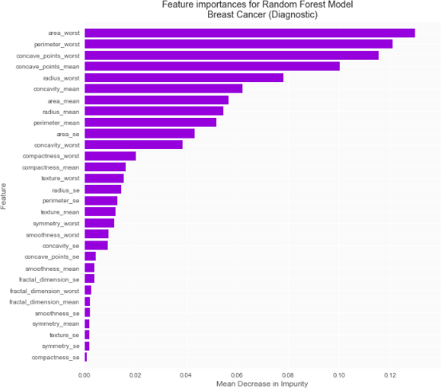
Variable Importance
## List the importance of the variables. var_imp_rf = variable_importance(fit_rf) Importances_rf = var_imp_rf[‘importance’]

Slide 10
Variable Importance
Random Forest computes two measures of Variable Importance
Mean Decrease in Accuracy
Mean Decrease in Gini
Mean Decrease in Accuracy is based on permutation
Randomly permute values of a variable for which importanceis to be computed in the OOB sample
Compute the Error Rate with permuted values
Compute decrease in OOB Error rate (Permuted- Not permuted)
Average the decrease over all the trees
Mean Decrease in Gini is computed as “total decrease in node
impurities from splitting on the variable, averaged over all trees”

Slide 11
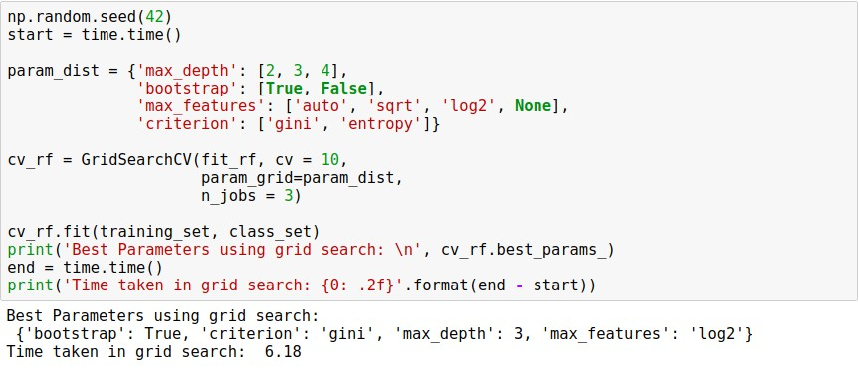
Finding optimal values using GridSearchCV

